Slide 1
Aggregate Query Prediction under Dynamic Workloads
Fotis Savva, Christos Anagnostopoulos, Peter Triantafillou
IEEE Big Data 2019 @ Dec 9-12 , Los Angeles, CA, USA

Slide 2
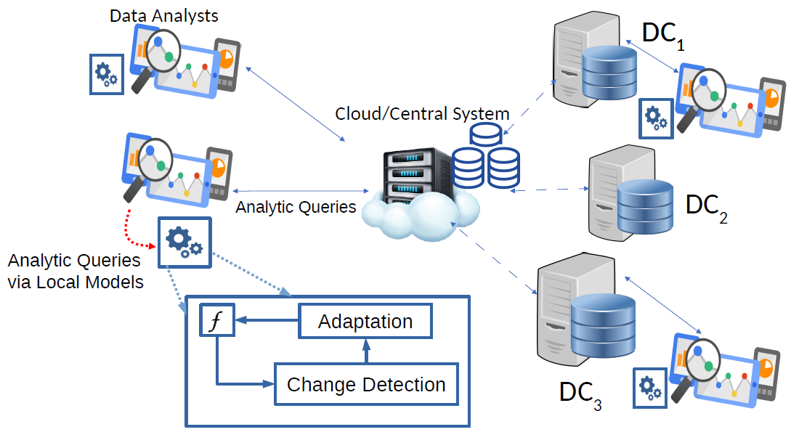
System Overview
Light weight mechanisms to be placed in Data Analysts machines
Data sets increase exponentially
They are increasingly being placed in geographically disparate regions
Need for light-weight mechanisms that are able to offer efficient approximate answers.
We can build light-weight mechanisms based on Query-Driven learning
Analysts connect and issue queries to different Data Centers (DC)
High energy, computational, memory, monetary costs
Notes:
Increasingly being placed in geographically disparate regions as indicated by the various Data Centers abbreviated as DC in the figure on the right.
Need for light-weight…. Answers. These mechanisms can be placed in Data Analysts machines so that the analysts can directly issue queries in their local machine.
But how are those mechanisms built, Can we take advantage of past queries to estimate ….

Slide 3
Query-Driven Learning
Making use of Machine Learning to train models based on previous queries

Slide 4
How to leverage Query-Driven Learning
1. Α query is issued using an SQL statement
2. Query is parsed and vector is extracted $q$
3. Queries are partitioned such that more similar queries are grouped together
4. Each partition is associated with a specific model
Notes:
Talk about training process and then prediction process

Slide 5
Query patterns change over time
Analysts’ interests change; Maybe new business directives ; new data sets. -> This causes changes in query patterns
Query Patterns Change -> The distribution $p\left(q\right)$ is non-stationary.
Hence, answers received from models $f∈F, F=\{f_{1},…,f_{k}\}$ are no longer trustworthy
Need to detect and adapt to these changes.
Solution : Use concept drift detection

Slide 6
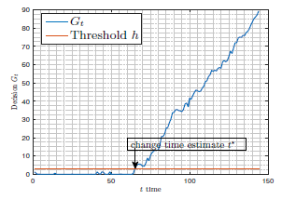
Change Detection Mechanism (CDM)
We use a variant of the CUSUM algorithm to detect when estimated errors shift
Errors are estimated using the Expected Prediction Error (EPE) and the distance of a query from its partition/group.
Sum of log-likelihoods
$G_{t}=\max\left(0, U_{t−1}−\min_{\left\{t∈\left[0,t−1\right]\right\}}{U_{t−1}}+s_{t}\right), G_{t}$ > h
where h is the threshold $3σ≤h≤5σ$
Discount factor
Log-likelihood ratio $s_{t}=\log{\frac{p_{1} (\hat{errors})}{p_{2}(\hat{errors})}}$
$p_{1}$ is the original distribution
$p_{2}$ is the “foreign” distribution
Notes:
For each query we get an estimate of its errors. Using a variant of CUSUM we monitor the probability distribution of the estimated errors and are able to identify when that probability distribution is shifting. This is a signal that tells us that most likely the query patterns have changed.

Slide 7
Adaptation Mechanism (ADM)
$f$1
$f$2
…
$f$k
q
Various models exist and each can be distinguished by its prototype.
Models :$M=\{f_{1},…, f_{k}\}$
Prototypes : $W=\{w_{1},…, w_{k}\}$
When CDM triggers for particular model. All queries are forwarded to the backend engine.
Leverage those queries to train a new prototype and model
$$w_{1}$$
$$w_{k}$$
$$w_{2}$$
$$\{\left(q_{t}, y_{t}\right),$$
.
.
.
$$({(q}_{t+n} y_{t+n})\}$$
$$w_{\left\{k+1\right\}}$$
Adapt prototype using SGD
$$w$$
$$w$$
$$w$$
$$w$$
$$w$$
$$w$$
Train model once prototype converged
Notes:
Once CDM has fired then that means the patterns for model have changed and it needs to be adapted

Slide 8
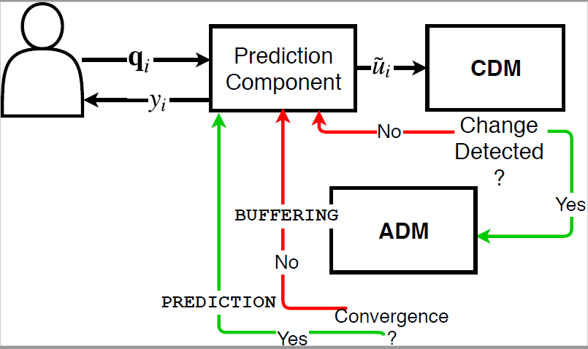
Overview of interaction for CDM and ADM
1. Detect Changes using the CDM
2. If a change has been detected switch to ADM
4. Switch back to normal operation upon convergence
At this point predictions from the model for which the CDM fired are not allowed.
3. The ADM adds a new representative and trains new model

Slide 9
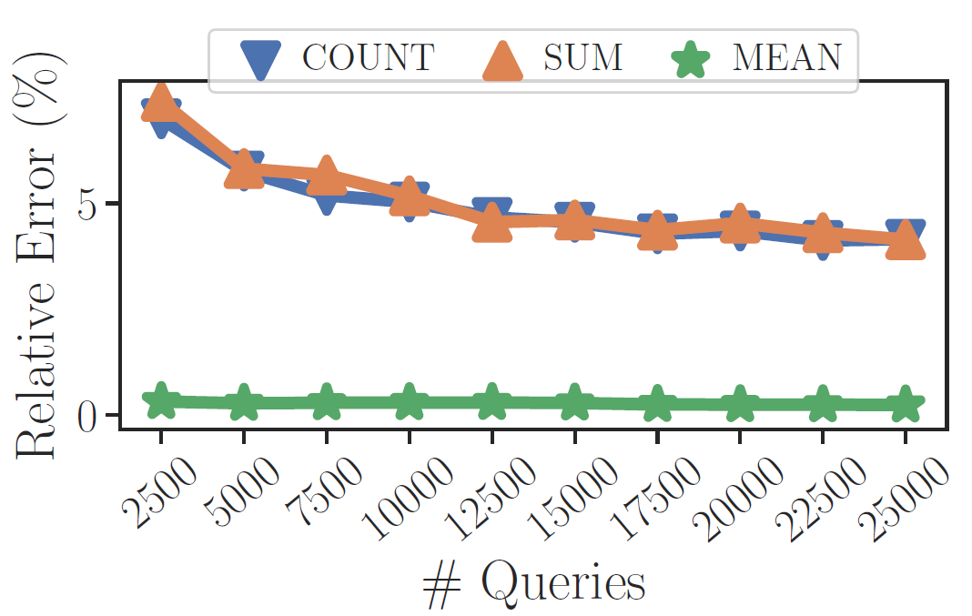
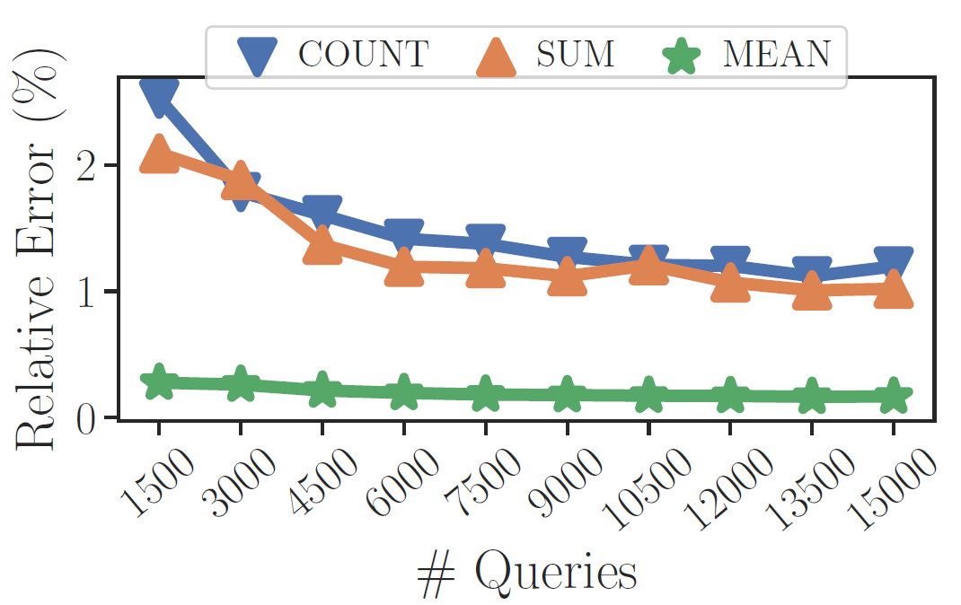
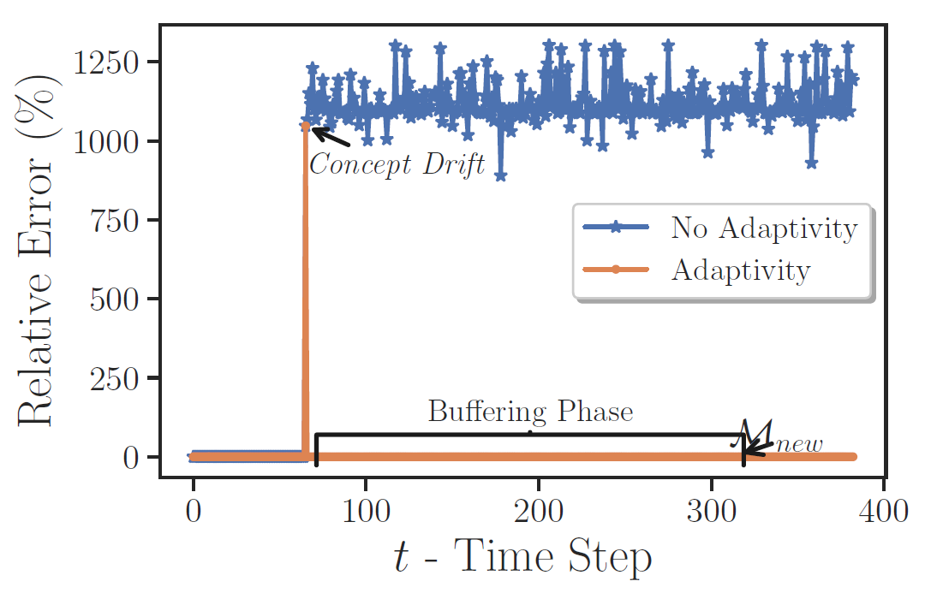
Experimental Results

Slide 10
Thank you for you attention
Please direct all your questions at : f.savva.1@research.gla.ac.uk

